Slide 1
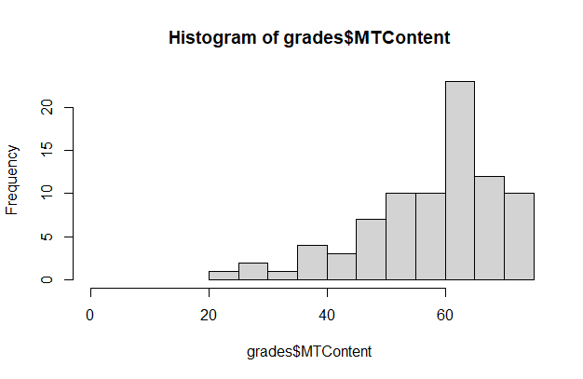
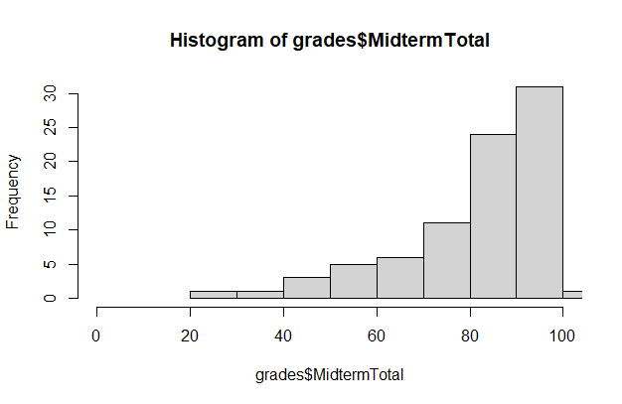
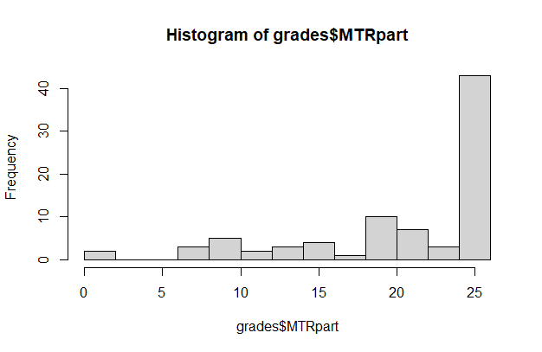
Exams are Graded
Feedback is posted.
Curved Exam 3 points: which put 4 people at 100, and 1 and a 101.
36As; 22Bs; 9Cs; 16 Fs.
Count | 83
Minimum Value | 23.00%
Maximum Value | 101.00%
Range | 78.00
Average | 81.96385%
Median | 85.50%
Standard Deviation | 16.15153
Variance | 260.87218

Slide 2
Non Linear Variables in Linear Models
The linear model assumes a linear relationship between response and predictors, but in some cases, the true relationship between the response and the predictors may be nonlinear.
We can use polynomial regression to accommodate non-linear relationships.

Slide 3
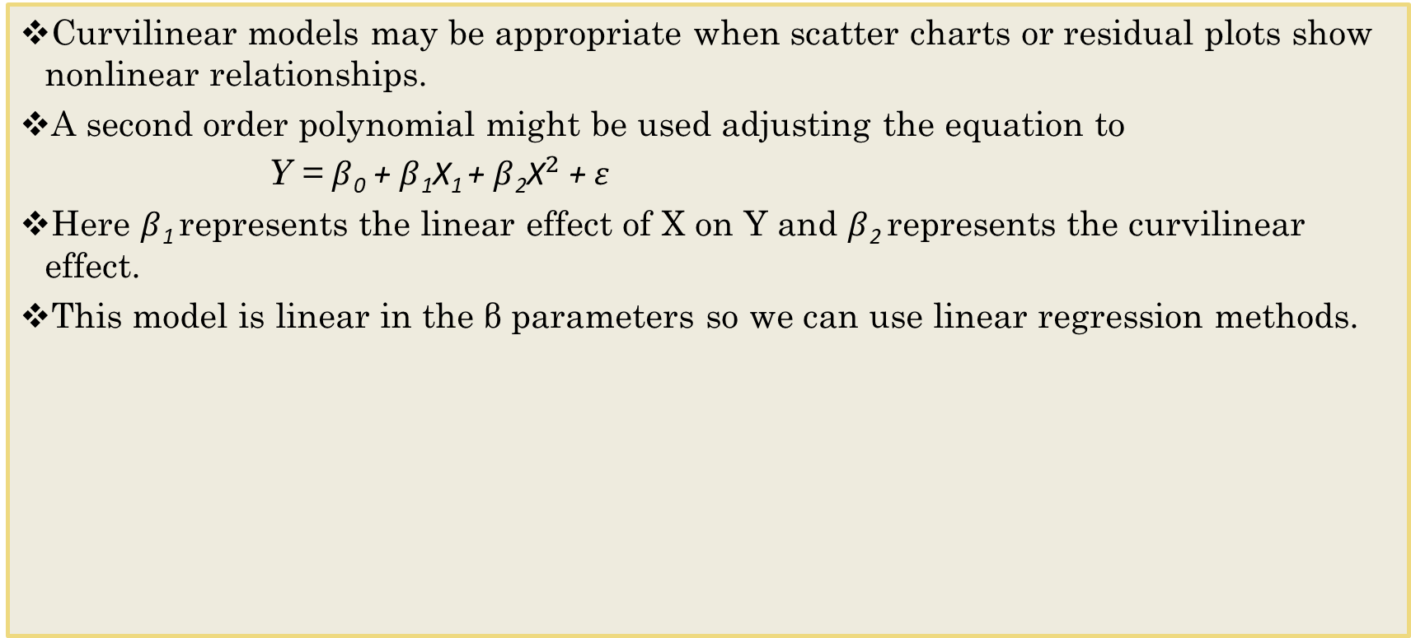
Regression Models with Nonlinear Terms
Curvilinear models may be appropriate when scatter charts or residual plots show nonlinear relationships.
A second order polynomial might be used adjusting the equation to
Y = $β$₀ + $β$₁X₁ + $β$₂${\text{X}}^{2}$ $\text{+} ε$
Here $β$₁ represents the linear effect of X on Y and $β$₂ represents the curvilinear effect.
This model is linear in the β parameters so we can use linear regression methods.

Slide 4
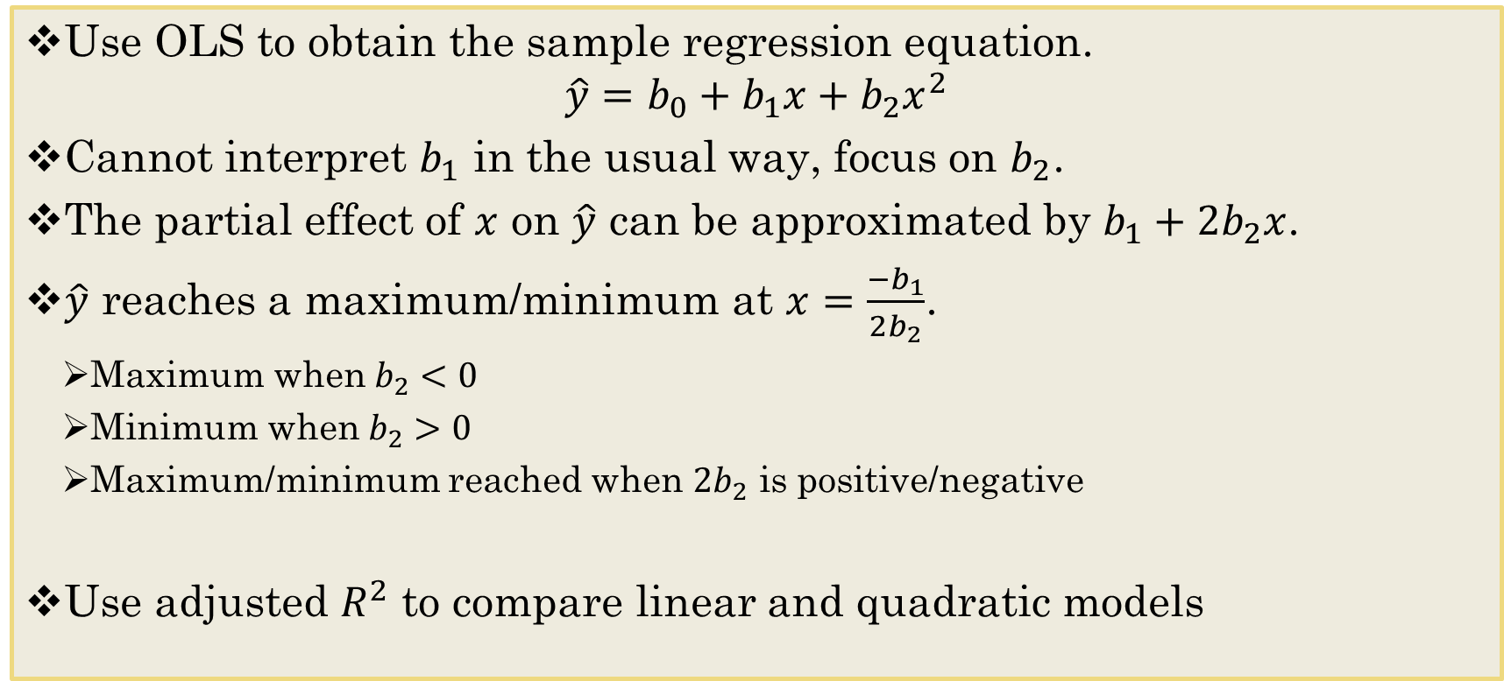
Quadratic Relationships
Use OLS to obtain the sample regression equation.
$$\hat{y}=b_{0}+b_{1}x+b_{2}x^{2}$$
Cannot interpret $b_{1}$ in the usual way, focus on $b_{2}$.
The partial effect of $x$ on $\hat{y}$ can be approximated by $b_{1}+{2b}_{2}x$.
$\hat{y}$ reaches a maximum/minimum at $x=\frac{−b_{1}}{2b_{2}}$.
Maximum when $b_{2}<0$
Minimum when $b_{2}>0$
Maximum/minimum reached when $2b_{2}$ is positive/negative
Use adjusted $R^{2}$ to compare linear and quadratic models

Slide 5
Caution with Polynomials
Polynomials are powerful tools but might backfire: when analyzing real data, we usually know little about it and therefore we need to be cautious because the use of high order polynomials (n > 4) may lead to over-fitting.

Slide 6
Regression Models – Natural Log Transformations
Another common transformation that captures nonlinearity is based on the natural logarithm.
The natural logarithm converts changes in a variable into percent changes.
This is useful because many relationships are naturally expressed in terms of percentages.
Use intuitive and statistical measures to determine the appropriate form.

Slide 7
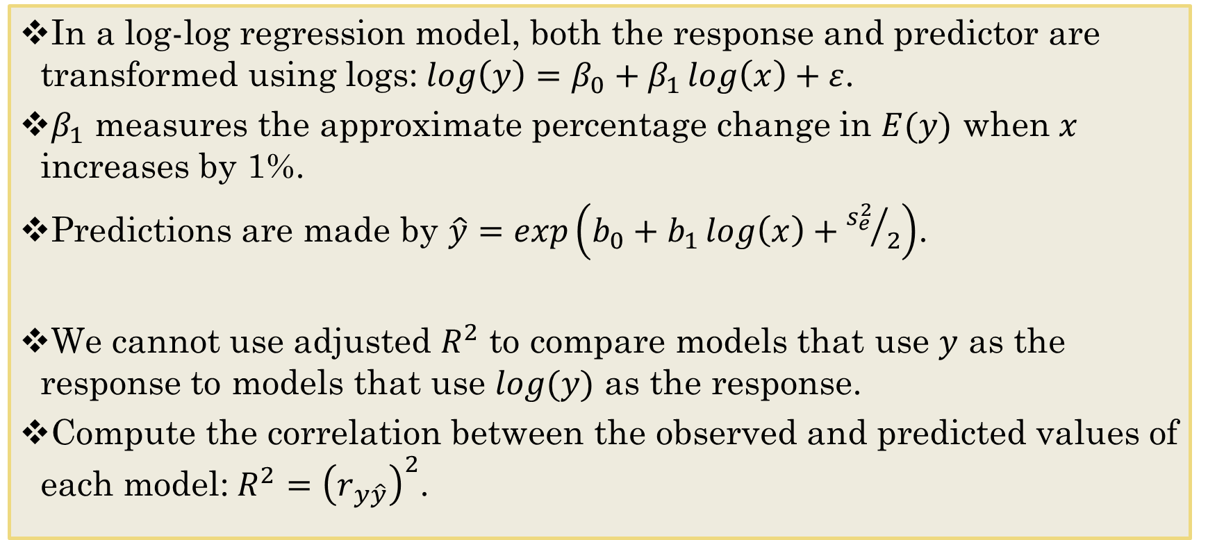
log-log Regression Models
In a log-log regression model, both the response and predictor are transformed using logs:$\log\left(y\right)=β_{0}+β_{1}\log\left(x\right)+ε$.
$β_{1}$ measures the approximate percentage change in $E(y)$ when $x$ increases by 1%.
Predictions are made by $\hat{y}=exp\left(b_{0}+b_{1}\log\left(x\right)+{s_{e}^{2}}/2\right)$.
We cannot use adjusted $R^{2}$ to compare models that use $y$ as the response to models that use $log⁡(y)$ as the response.
Compute the correlation between the observed and predicted values of each model:$R^{2}={\left(r_{y\hat{y}}\right)}^{2}$.

Slide 8
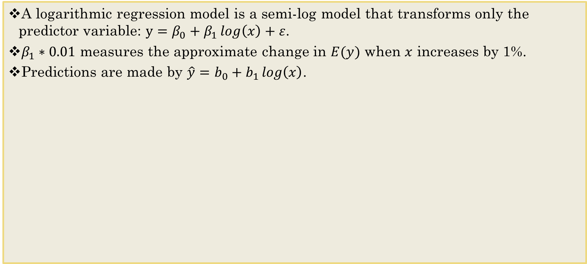
Semi-log model Transformations
A logarithmic regression model is a semi-log model that transforms only the predictor variable: $y=β_{0}+β_{1}\log\left(x\right)+ε$.
$β_{1}∗0.01$ measures the approximate change in $E(y)$ when $x$ increases by 1%.
Predictions are made by $\hat{y}=b_{0}+b_{1}\log\left(x\right)$.

Slide 9
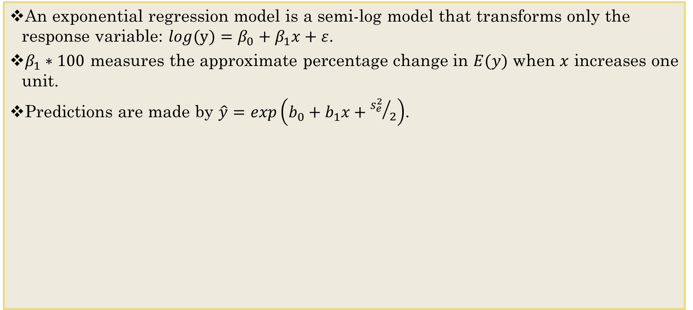
Exponential Regression
An exponential regression model is a semi-log model that transforms only the response variable: $log(y)=β_{0}+β_{1}x+ε$.
$β_{1}∗100$ measures the approximate percentage change in $E(y)$ when $x$ increases one unit.
Predictions are made by $\hat{y}=exp\left(b_{0}+b_{1}x+{s_{e}^{2}}/2\right)$.

Slide 10
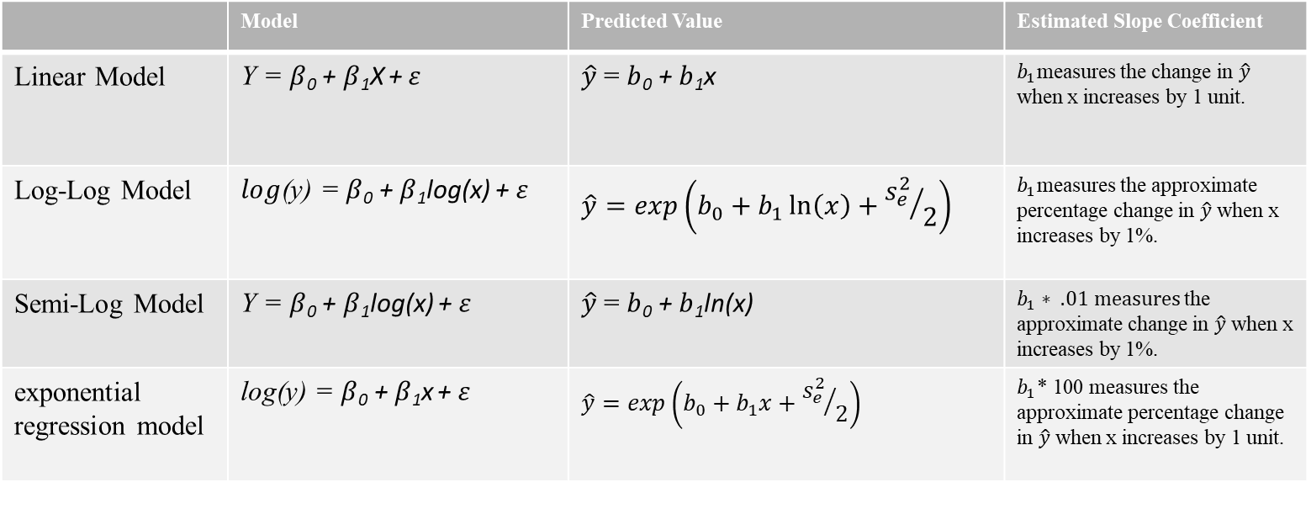
Summing up those Models
 | Model | Predicted Value | Estimated Slope Coefficient
Linear Model | Y = $β$₀ + $β$₁X $\text{+} ε$ | $\hat{y}$ = $b$₀ + $b$₁x | $b_{1}$measures the change in $\hat{y}$ when x increases by 1 unit.
Log-Log Model | $log$(y) = $β$₀ + $β$₁log(x) $\text{+} ε$ | $$\hat{y}=exp\left(b_{0}+b_{1}\ln\left(x\right)+{s_{e}^{2}}/2\right)$$ | $b_{1}$measures the approximate percentage change in $\hat{y}$ when x increases by 1%.
Semi-Log Model | Y = $β$₀ + $β$₁log(x) $\text{+} ε$ | $\hat{y}$ = $b$₀ + $b$₁ln(x) | $b_{1}∗ .01 measures$the approximate change in $\hat{y}$ when x increases by 1%.
exponential regression model | log(y) = $β$₀ + $β$₁x $\text{+} ε$ | $$\hat{y}=exp\left(b_{0}+b_{1}x+{s_{e}^{2}}/2\right)$$ | $b_{1}$* 100 measures the approximate percentage change in $\hat{y}$ when x increases by 1 unit.

Slide 11
To Do
Work on Non-Linear Swirl

